Slide 1
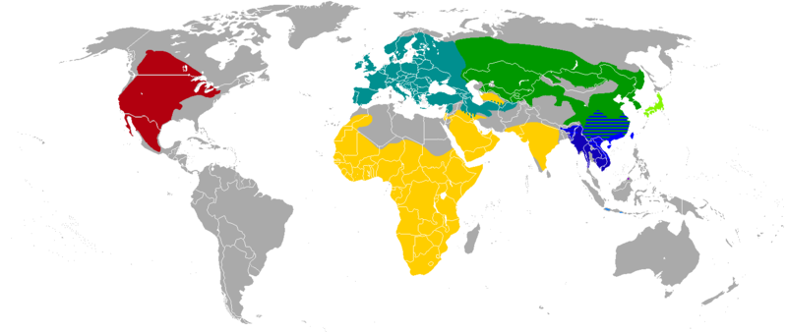
Distribution of species
https://en.wikipedia.org/wiki/File:Badger_species_map.png
Wubing Xu (wubing.xu@idiv.de)
Notes:
Characteristics of species ranges:
Definition of species distribution (scale-dependent)
size (latitudinal pattern, Rapoport hypotheses; measures: Gaston 2009);
shape (north-south vs west-east);
Internal structure within ranges: abundance-center hypotheses
Potential determinants of species ranges:
abiotic, biotic, dispersal
Empirical evidence for range-limiting factors: unequilibrient: glaciation;
Changes of species distributions:
elevational shits;
human activities (Wubing, Ingmar GEB),
extinction risk (mammal, Nature),
biological invasive (Nature)
Database of species distributions
IUCN range maps, GBIF, BIEN

Slide 2
The distribution of a species
The geographical locations of all its individuals
during a specified period of time
Lomolino et al. 2010+ Stan Shebs

Slide 3
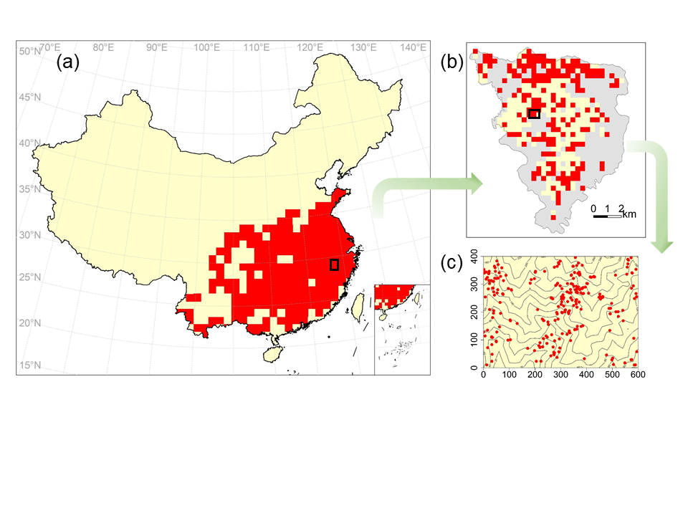
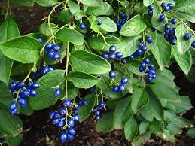
Scale-dependent species distributions
Geographic range of species in China
Species distribution at the Gutianshan Nature Reserve
Distribution of individuals in the Gutianshan Forest Dynamic Plot (600 × 400 m)
Symplocos paniculata
Notes:
Figure 1.1 The distribution of Symplocos paniculata at three spatial scales
geographic range of species in China
species distribution at the Gutianshan Nature Reserve
distribution of individuals in the Gutianshan Forest Dynamic Plot (600 × 400 m)

Slide 4
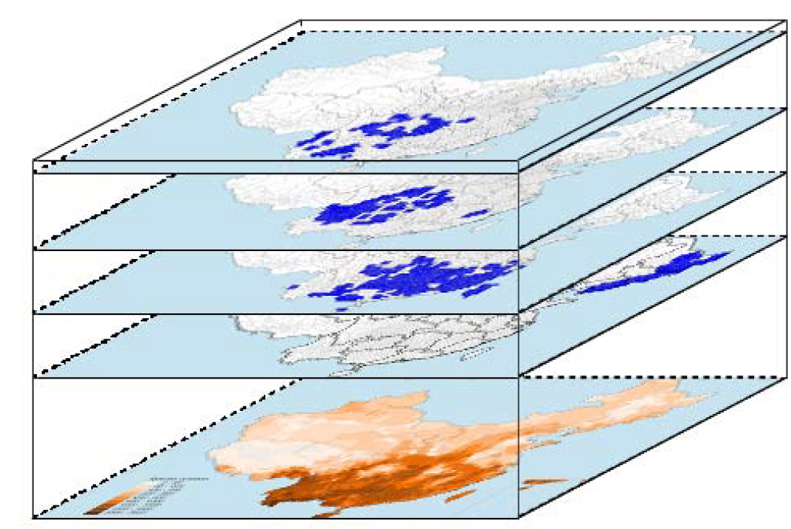
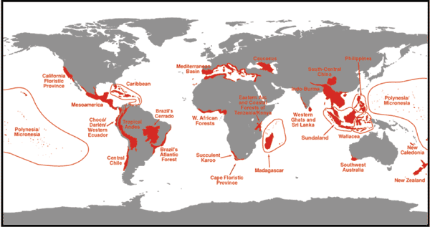
Why species distributions？
Understanding the factors shaping species’ ranges is a central question in both ecology, evolutionary biology and conservation biology
Species richness = aggregated ranges
Decide where to preserve biodiversity
25 global biodiversity hotspots
Wang 2008 PhD thesis
Myers 2000 Nature
Notes:
Divide to 3-4 slides

Slide 5
Why species distributions？
Practical urgency: climate change, biological invasions, land-use impacts
Geographic range size is a key predictor of extinction risk (Purvis et al. 2000 Proc R Soc B, Thomas et al. 2004 Nature).
Key quantity in IUCN Red List criteria.

Slide 6
Topics
Characteristics of species ranges
Potential determinants of species ranges
Changes of species distributions
Some database of species distributions
Notes:
Characteristics of species ranges

Slide 7
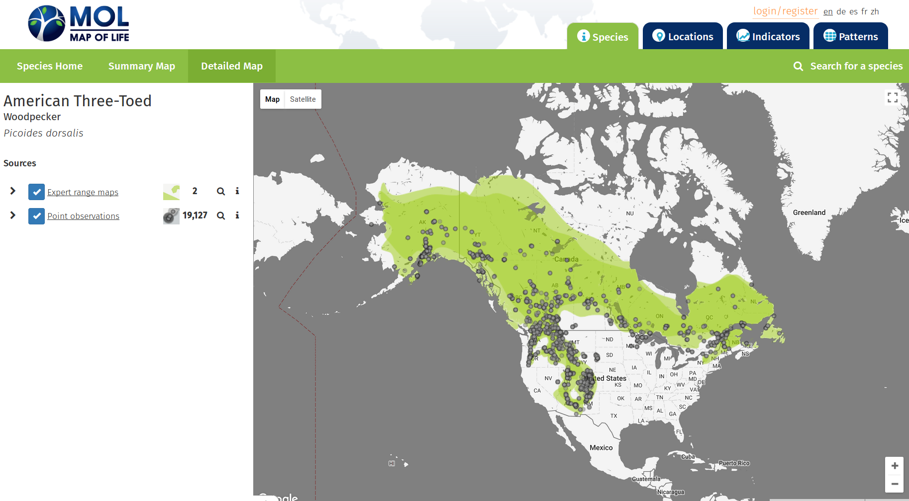
Point observations and geographic range
Georeferenced records (dot maps)
Only presences
Outline maps
Subjectivity
Often no info on abundance
Notes:
Picoides dorsalis

Slide 8
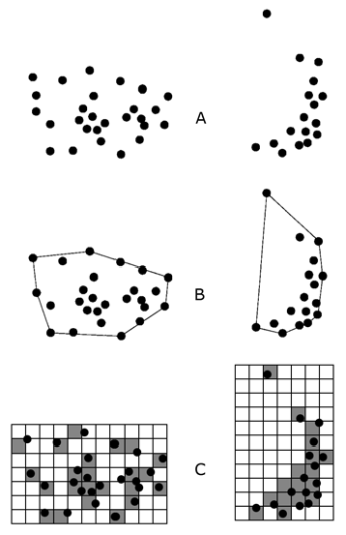
Estimation of range size
EOO (extent of occurrences)
Area within the outermost geographic limits
Difficult to draw for discontinuous ranges
AOO (Area of occupancy)
The area that a species actually occurs within geographic limits
Usually based on gridded data (resolution)
Point observations
EOO
AOO
Gaston & Fuller 2009, J Appl Ecol

Slide 9
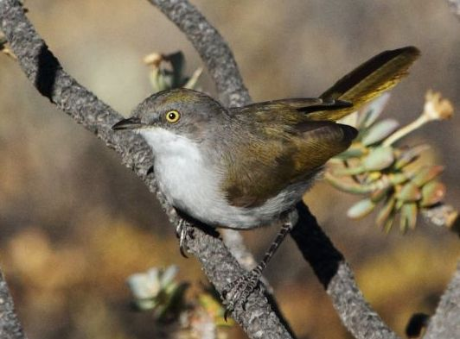
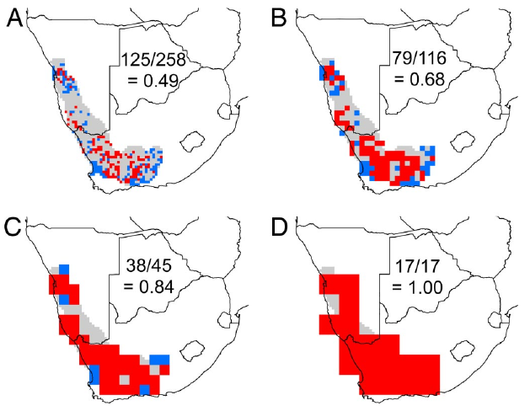
AOO increases with grid resolutions
0.25°
0. 5°
Eremomella gregalis
1°
2°
Range size
Presence
Absence
Grid resolution
Hurlbert & Jetz (2007) PNAS

Slide 10

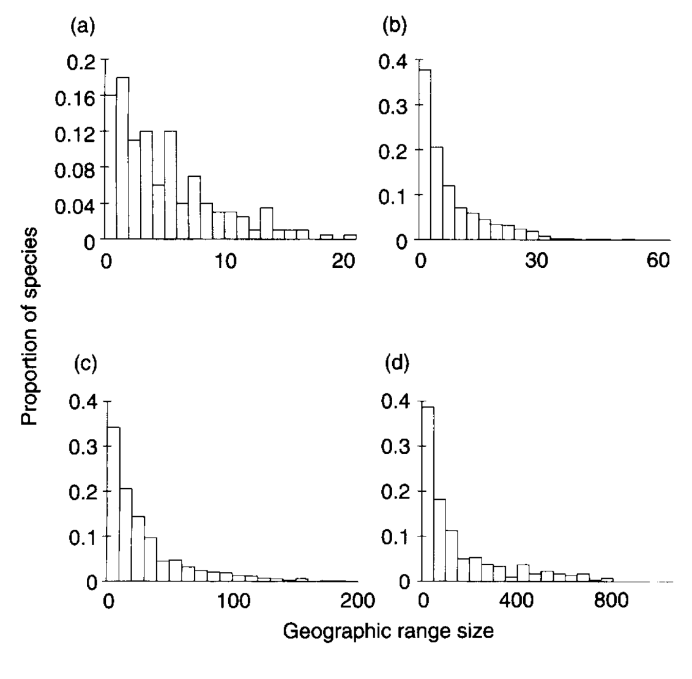
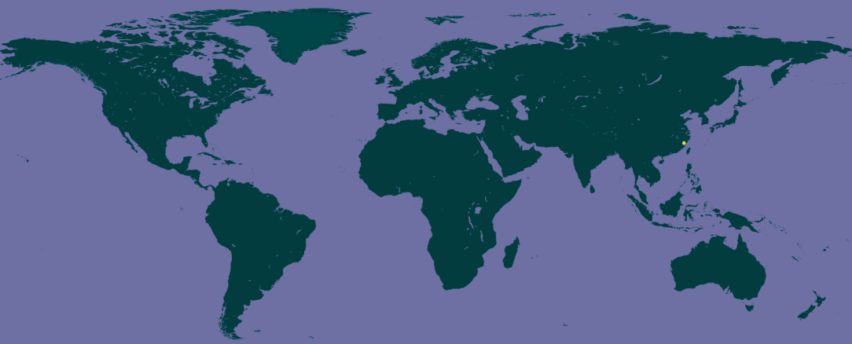
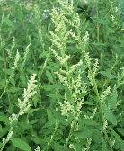
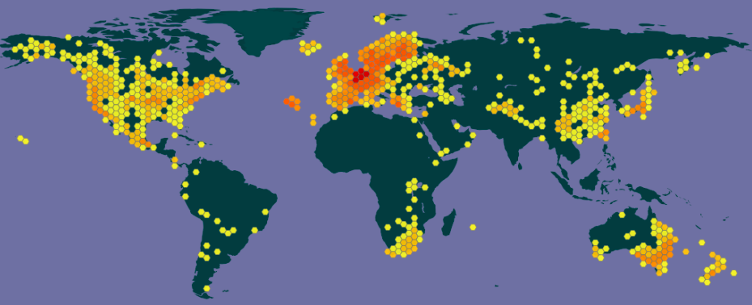
Endemic vs widespread species
Histogram of range sizes of birds
Abies beshanzuensis M. H. W（百山祖冷杉）
North America
New world
Chenopodium album L.（藜）
Africa
Australia
(From GBIF)
Gaston, 1996, TREE

Slide 11
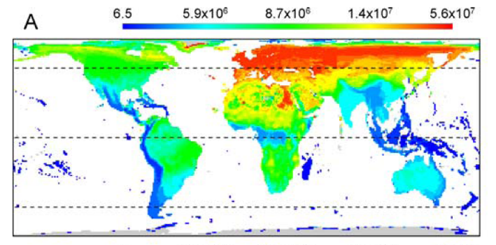
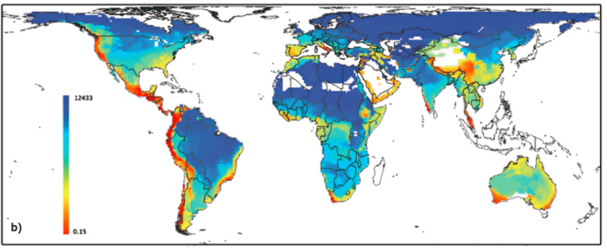
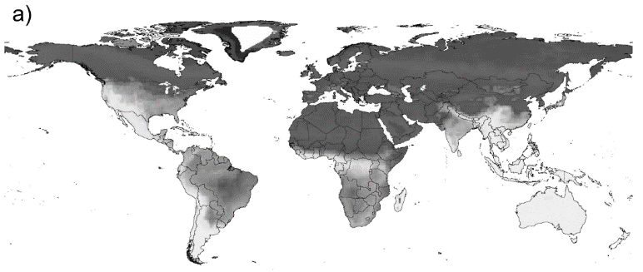
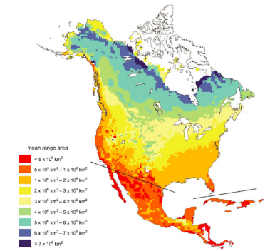
Spatial patterns of species’ range size
Amphibians (Whitton et al. 2012)
Birds (Orme et al. 2006)
Overall, small ranges are mostly distributed in islands, mountains and low latitudinal areas
Mammals (Davis et al. 2009)
Trees (Morin et al. 2011)
Notes:
Overall, small ranges are mostly distributed in islands, mountains and low latitudinal areas
很多研究发现物种的分布区大小在空间上并不是均匀分布的，有些地区的物种分布区比较大，而另外一些地区的比较小。这里展示的是全球两栖类、鸟类、哺乳动物和北美乔木树种的格局，总体上看，较小的分布区出现在岛屿、山区和低纬度地区。虽然已经有了不少研究，但格局背后的机制还存在很多争论，特别是关于植物的分布区大小格局，主要受限于分布数据还比较缺乏。

Slide 12
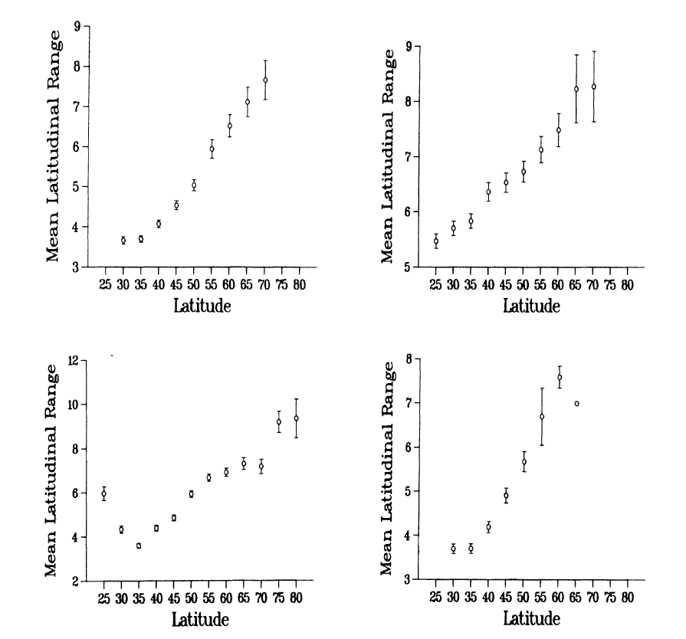
Rapoport’s rule: increasing geographic range sizes with latitudes
Trees
Marine mollusks
Latitudinal patterns of geographic range sizes for different taxa in North America
Freshwater/coastal fishes
Reptiles and amphibians
Stevens 1989, American Naturalist

Slide 13
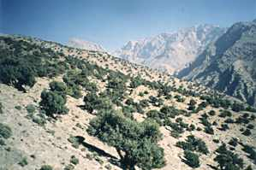
Internal range structure
Spatial variation in presence and abundance within ranges
Distributions of individuals
Similar extent of occurrences (EOO)
Different areas actually occupied (AOO)
Juniper distribution

Slide 14
How are individuals distributed w/in a species’ range?
Aggregated
Aggregated distribution are ubiquitous
Regular
Random
Lomolino et al. 2010+ www

Slide 15
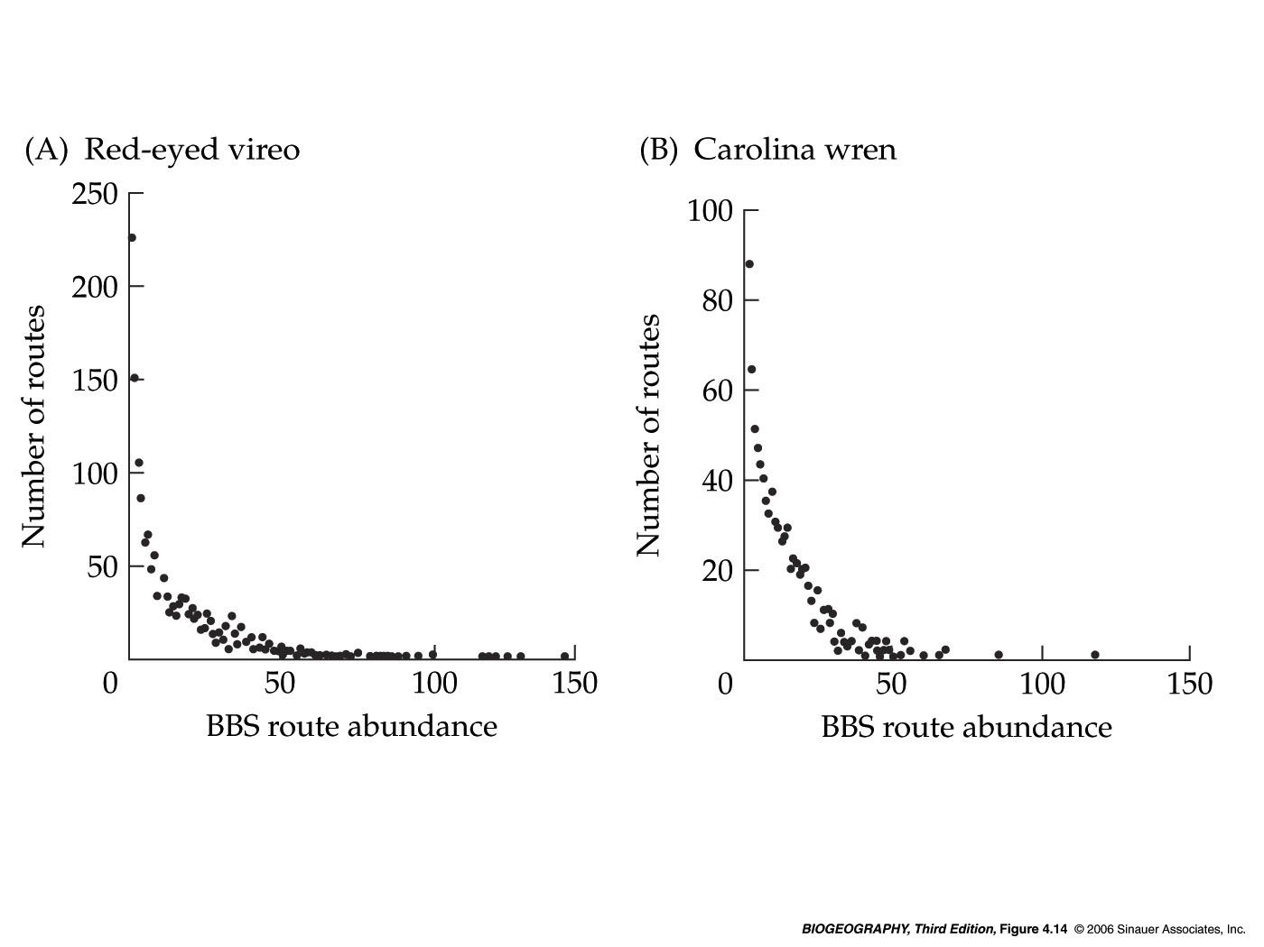
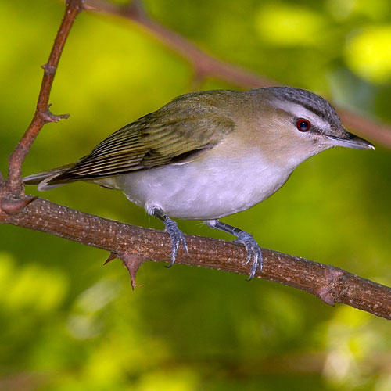
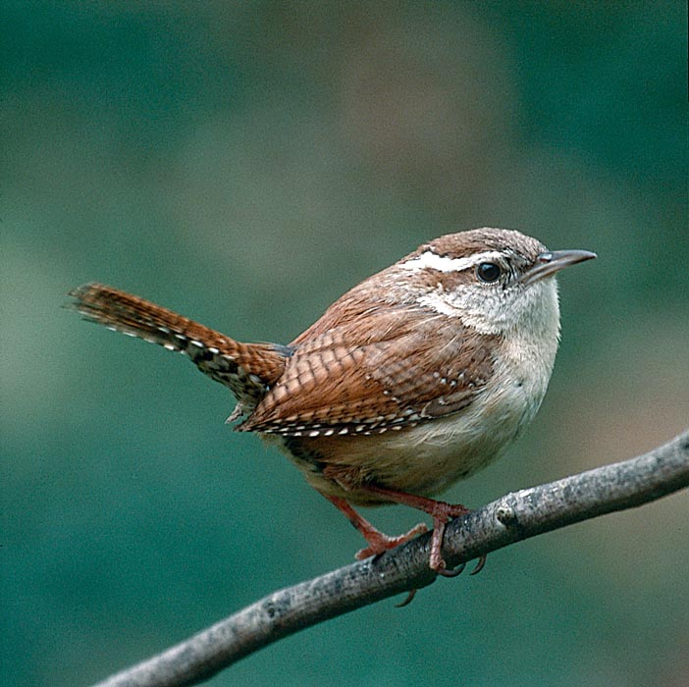
Spatial variation in abundance
Any given species is typically only abundant at a minority of its occupied sites (’hotspots’)
For both species, only one individual was recorded on the majority of routes.
Notes:
results of standardized census routes of the North American Breeding Bird Survey.

Slide 16
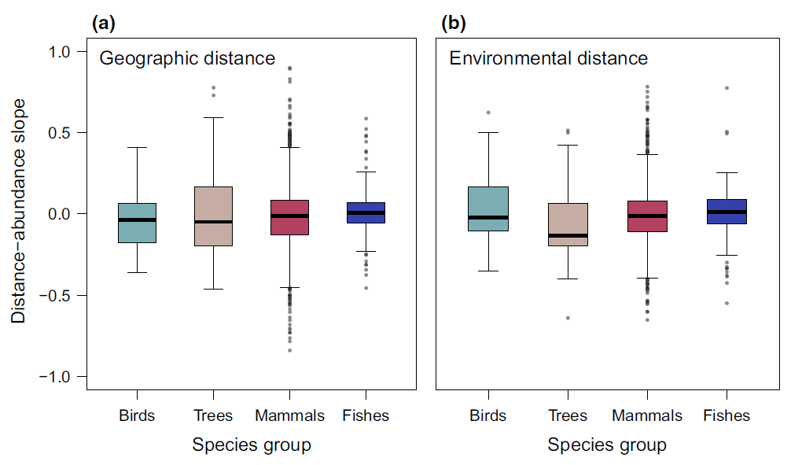
Abundant-centre hypotheses
Prediction
High Abundance in centers of geographic ranges and environmental space
Abundance
Margin
Center
Geographical/environmental space
Weak empirical evidence
Distance–abundance correlations for over 1600 species
Dallas et al. 2017, Ecol Lett

Slide 17
Dynamics of ranges
Stasis post-expansion
Positional shift
Area~ age
+ positional shift
Stasis
Cyclic
Idiosyncratic
Potential ways in which geographic range size and position very through time
Gaston (2003) The structure and dynamics of geographic ranges
Time
Notes:
Potential ways in which geographic range size and position very through time

Slide 18
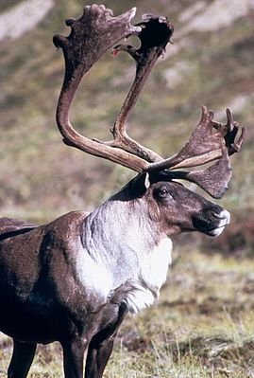
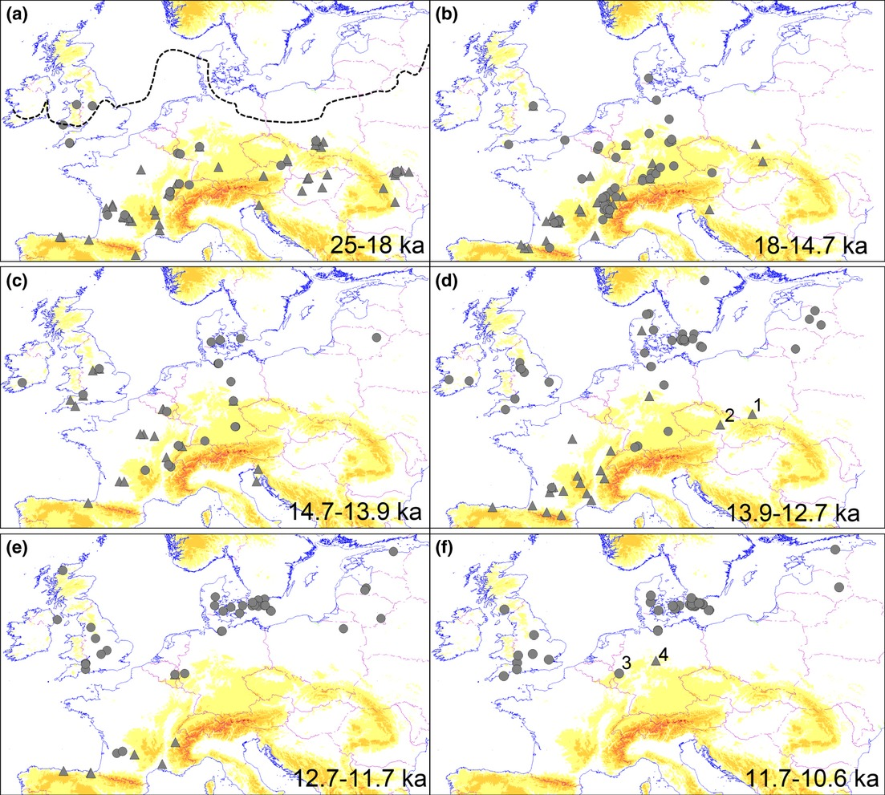
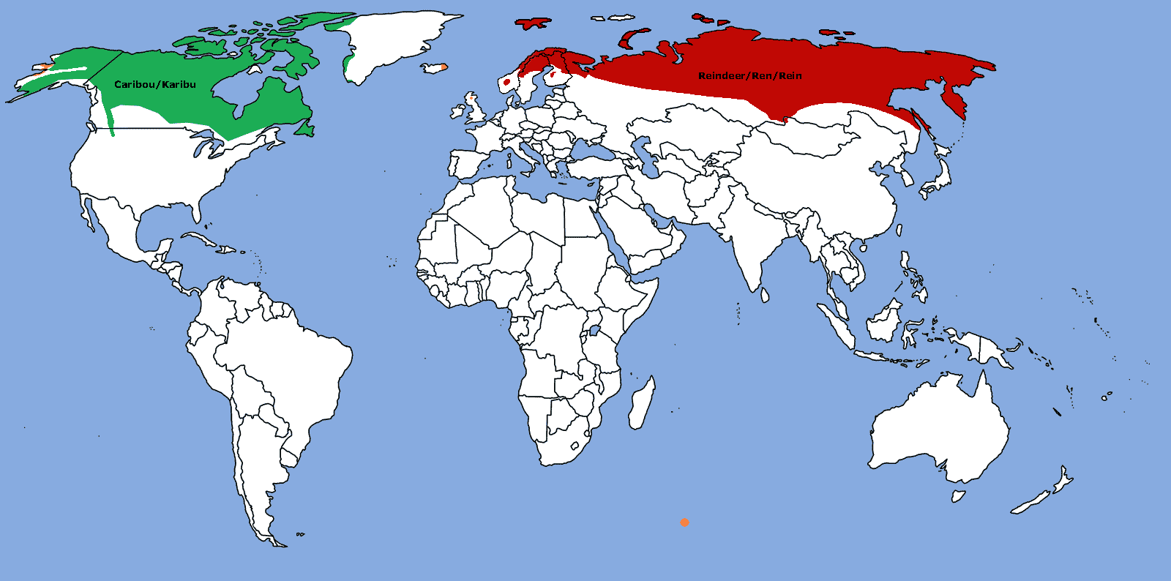
Long-term dynamics
Points: Locations of fossil records
Reindeer
(Rangifer tarandus)
The margin of the ice sheet
Today
Sommer et al. 2014. J. Biogeogr.
Notes:
https://de.wikipedia.org/wiki/Ren
The dotted line in panel (a) indicates the margin of the ice sheet

Slide 19
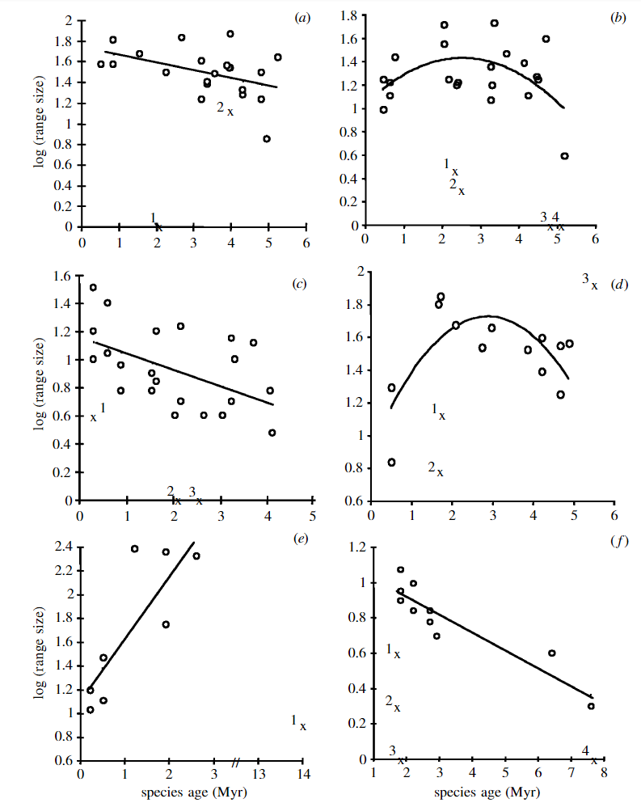
Geographic range size and evolutionary age in birds
Acrocephalus+
Hippolais
Range sizes are not static over evolutionary time
Range sizes appear to expand rapidly after speciation; and then gradually decline as species age
Dendroica
Range size
Ciconidae
Icterus
Webb & Gaston (2000) Proc. Roy. Soc. Lond. B 267:1843-1850
Sulidae
Diomedea
Species age
Notes:
Webb 和Gasten (2000)等对六个鸟类类群研究发现，当物种形成后分布区总体上迅速扩张，然后随物种进化年龄逐渐降低。
Here, we use independentlyderived molecular data to estimate ages of species in six monophyletic groups of birds, and examine therelationship between species age and global geographic range size

Slide 20
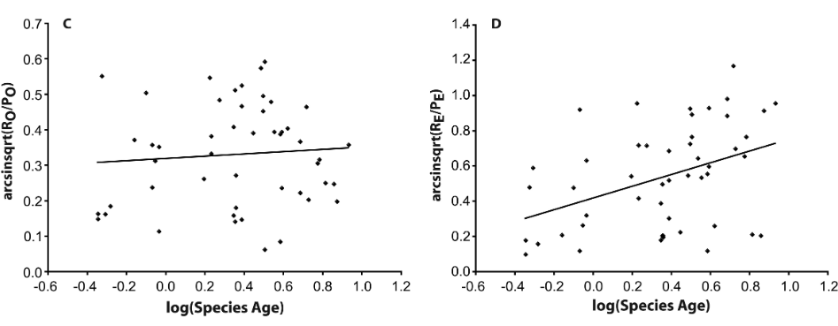
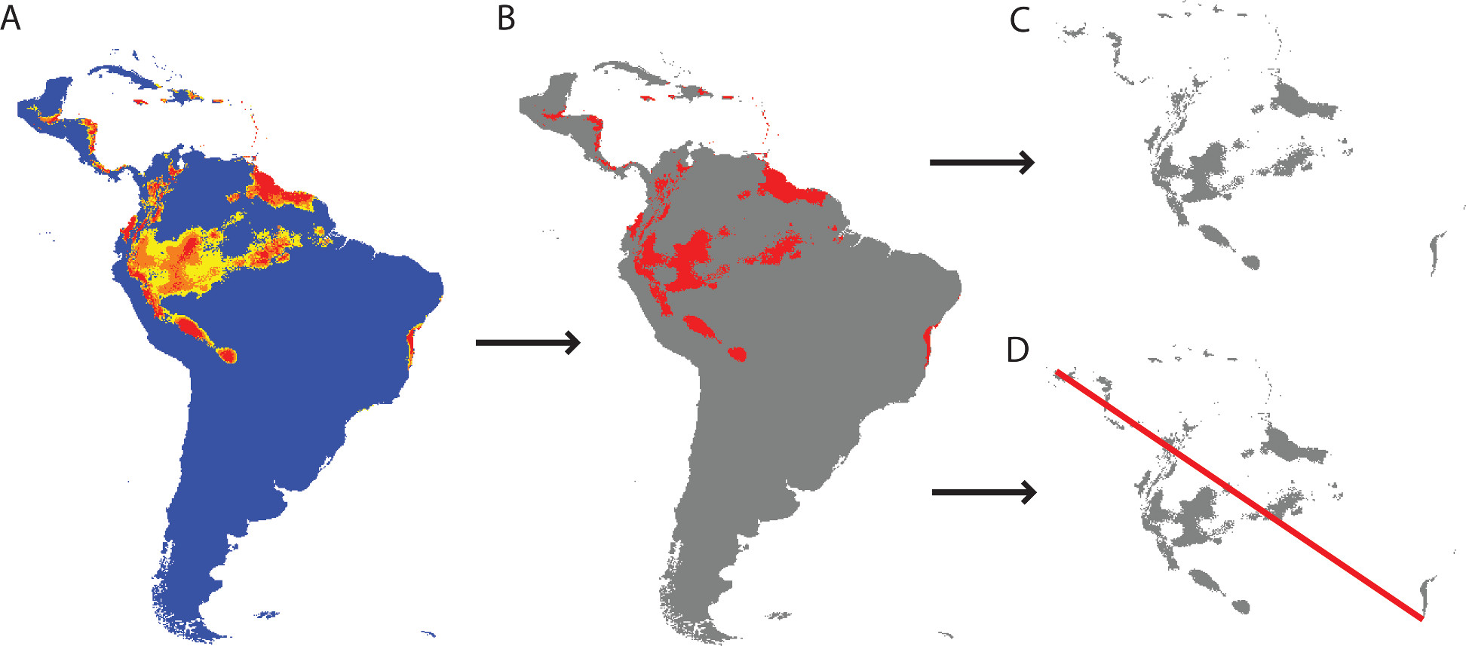
Evolutionary time vs. filling of potential ranges
A time‐for‐dispersal effect limit the extent of ranges but not their occupancies
Psychotria
Occupancy
Climatic potential ranges
Potential range occupancy
Filling of potential range
Extent
Potential range extent
Paul et al. Am Nat 2009
Notes:
Paul 等(2009)对植物研究发现，年轻的物种可能没有充足的时间占据它们潜在的
分布区域范围。但是，分布区大小与物种年龄的关系并不一定有因果关系，因为
分布区小的物种的灭绝风险更大，上述两者存在正相关关系可能是由于分布区小
的物种灭绝造成的(Pigot et al., 2012)。

Slide 21
Potential determinants of species distributions
= Potential causes of geographic range limits
Notes:
Potential determinants of species distributions
Potential causes of geographic range limits

Slide 22
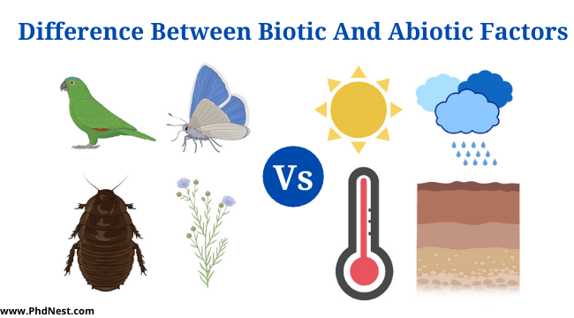
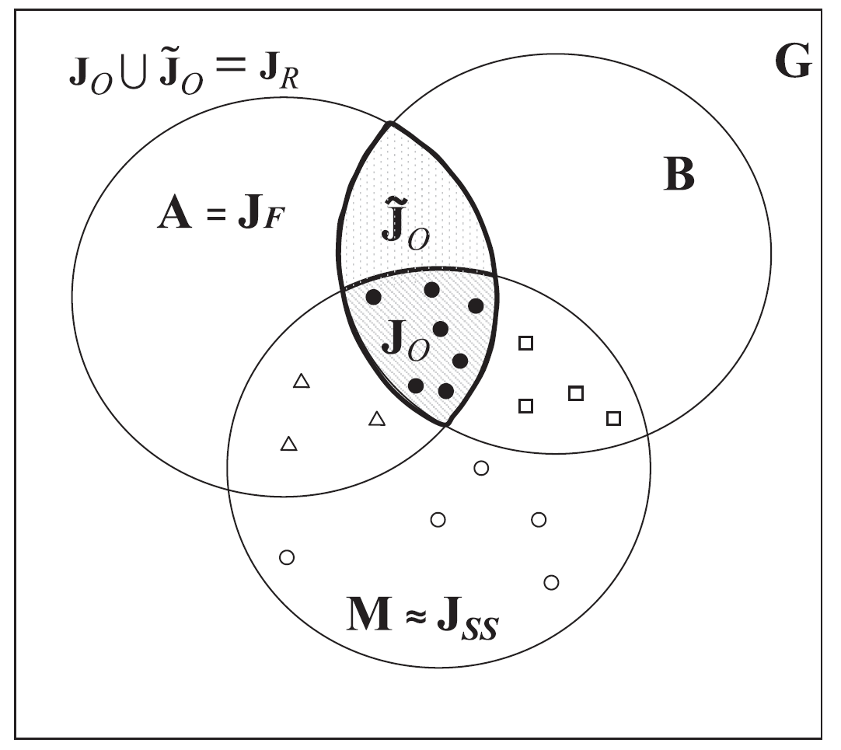

Fundamental factors in Soberón’s framework
biotic factors
Abiotic factors
J Soberón 2007 Ecol Lett 10:1115-1123.
Accessible given the dispersal capacities (migration)

Slide 23
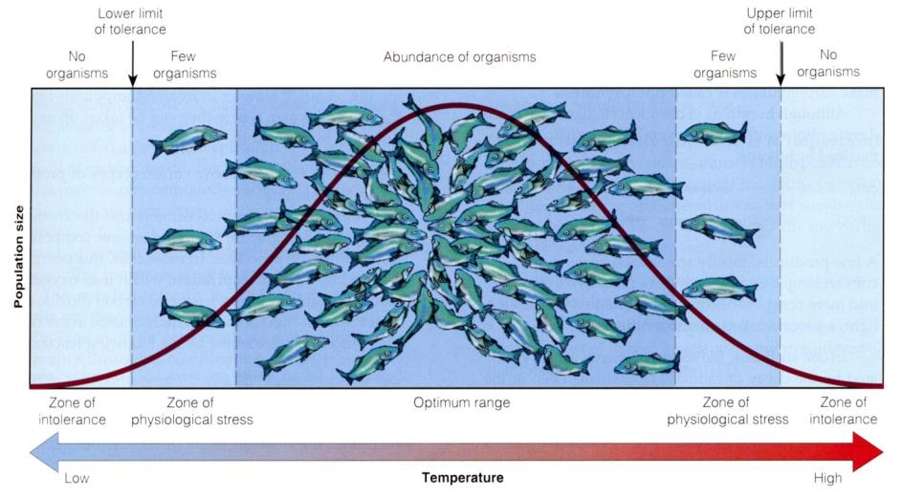
(Grinnellian) Niche - tolerance limits
Environmental Gradient
All species have tolerance limits for environmental factors beyond which individuals cannot survive, grow, or reproduce

Slide 24
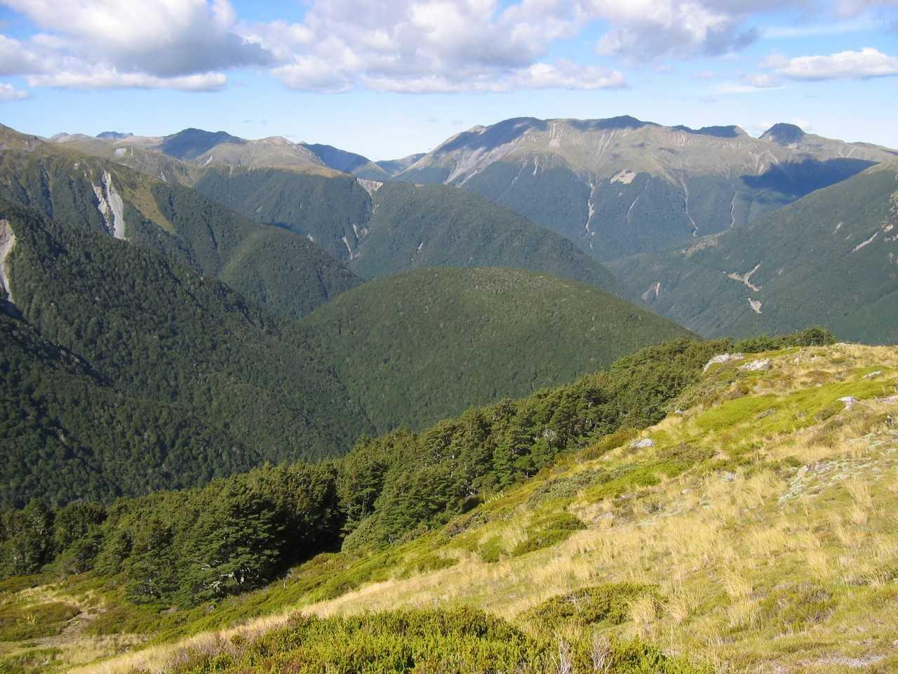
Treeline in southern Alps
Treeline is the upper elevational limit of trees on mountains.
Seems to be related to temperature, wind, snow depth etc.
Photo by M. Y. Bader

Slide 25
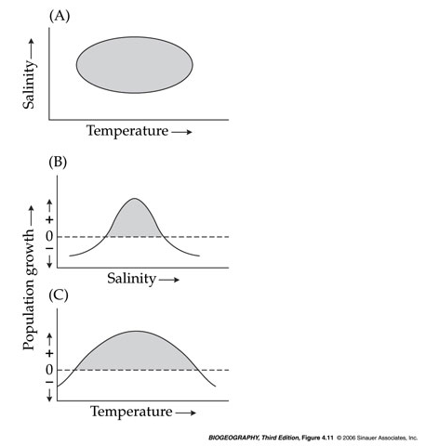
Niche perspective on range limits
r: intrinsic population growth rate in the absence of migration
r < 0
r > 0
r = b – d
b: birth rate
d: death rate
Hutchinson multidimensional niche
A diagram shows a niche in two dimensions
Notes:
B: birth rate
D: Death rate
Hutchinson multidimensional niche

Slide 26
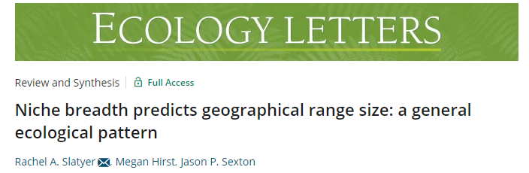
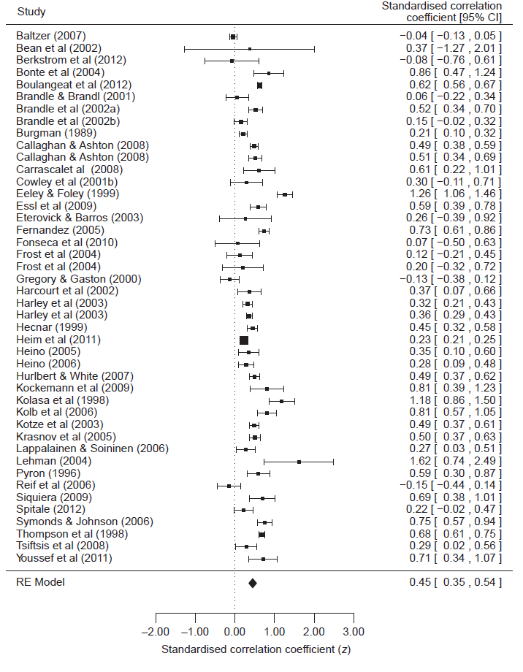
Range size vs. niche breadth
Synthesize 64 studies
A significant positive relationship between range size and environmental tolerance breadth (z = 0.49), habitat breadth (z = 0.45), and diet breadth (z = 0.28).
Slatyer & Sexton 2015, Ecol Lett

Slide 27
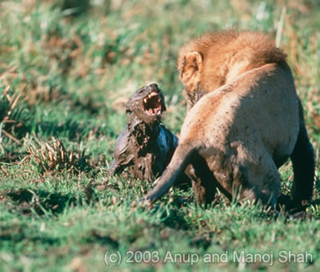
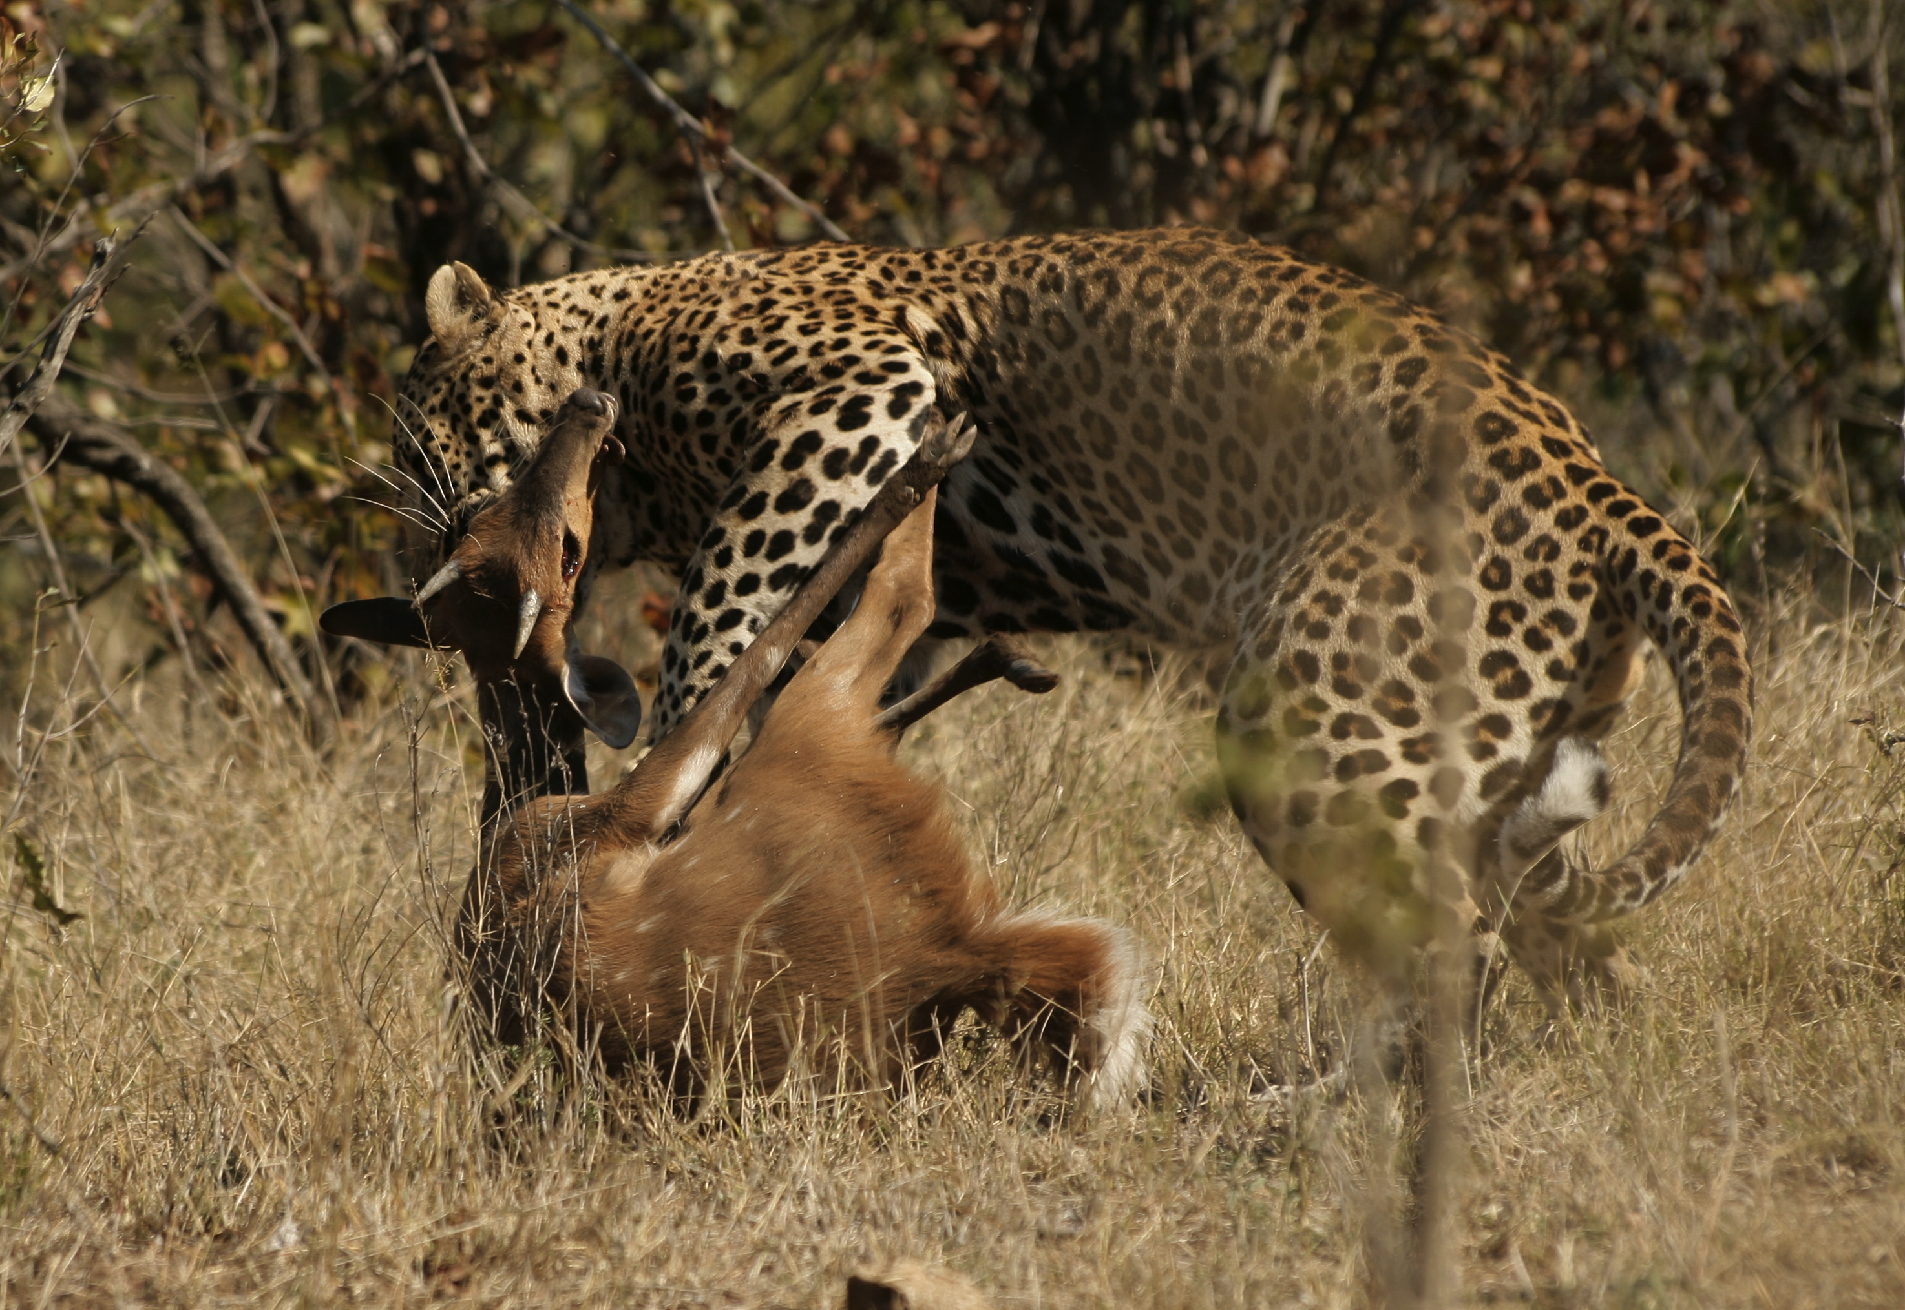
Biotic interaction
Competition for food
The three most significant of these interactions are:
1. Competition
2. Predation (or parasitism)
3. Mutualism
Predation
Mutualism (pollination )
Notes:
African lions and hyaenas compete for food.
Predation in action. Leopard—Panthera pardus—killing a young bushbuck—Tragelaphus sylvaticus by NJR ZA, CC BY-SA 3.0

Slide 28
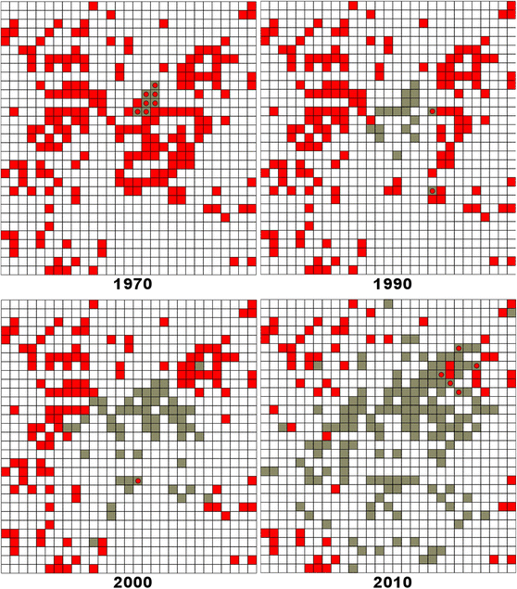
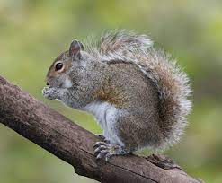
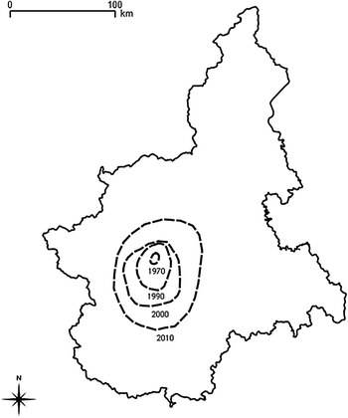
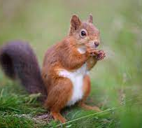
Competition
The effects of introduced grey squirrel (Sciurus carolinensis) on the native red squirrel (Sciurus vulgaris)
Sciurus carolinensis
Sciurus vulgaris
Distribution maps of red (red square) and grey (grey square) squirrels in Piedmont, Italy, from 1970 to 2010.
Bertolino et al. 2014 Biol. Invasions
Notes:
Grey squirrel adapt to climate and habitats in both North and South Europe, causing extinction of the native red squirrel
Rather much circumstantial evidence for mammals & birds
Probably less important in plants!
Why?
Because plants are sessile & interactions local
Red and grey squirrels

Slide 29
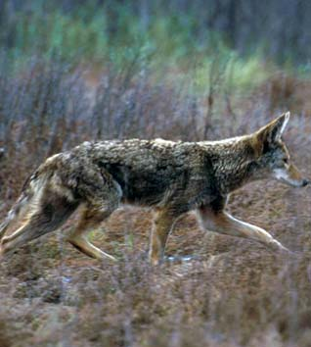
Predation and parasitism
There are a couple of ways in which predator-prey interactions can influence distribution patterns:
Predators that rely on specific prey are restricted by the distribution of the prey.
Predators may limited prey distributions by killing and eating prey organisms.

Slide 30
Mutualisms
Mutualisms are interspecific interactions in which both species benefit.
Pollination
Dispersal seed
Mycorrhiza –plants

Slide 31
Biotic vs abiotic range limits – geographical rules?
Stressed vs productive margins:
Abiotic limits in stress- dominated environments
Biotic limits in competition-dominated productive environments
Polar vs equatorial margins:
Polar limits:
abiotic (climatic)
Equatorial:
biotic (competition)

Slide 32
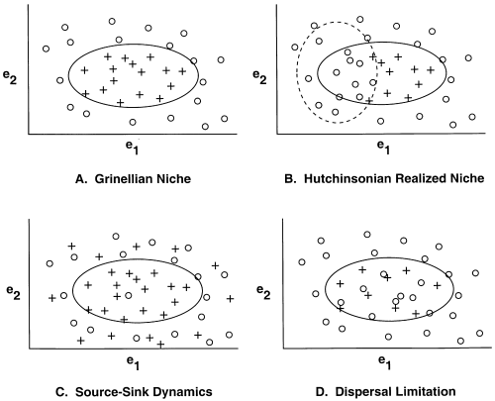
Dispersal effects on stable range limits
+ presence
absence
Source-sink dynamics
species may occur in environmental unsuitable sink habitats
r < 0
r > 0
r = intrinsic
population
growth rate in
the absence of
immigration
Dispersal limitation
Some suitable habitats maybe not occupied
r < 0
r > 0
Pulliam (2000) Ecol Lett 3:349-361.
Notes:
the solid oval refers to the fundamental niche or the combination of environmental factors (e₁ and e₂) for which the species has a finite rate of increase (λ) greater than or equal to 1.0.

Slide 33
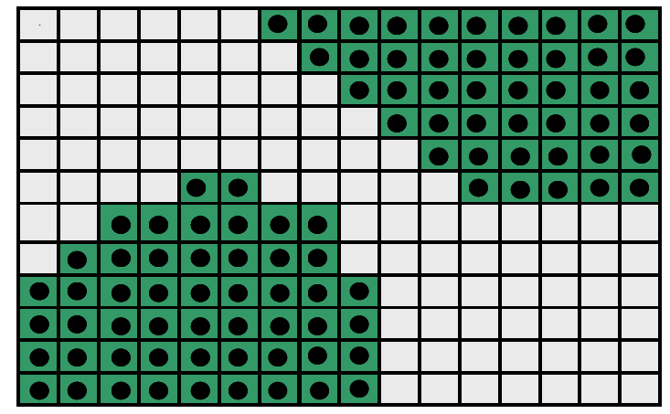
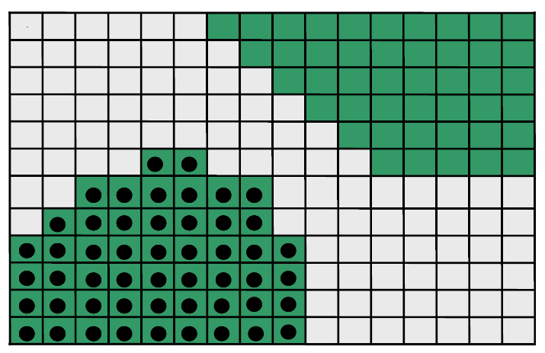
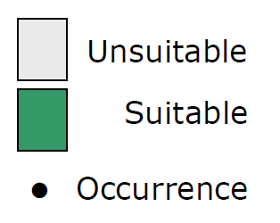
Disequilibrium range limits
Are species ranges in equilibrium with current environment (climate etc)?
To what extent have species failed to occupy suitable areas?
Equilibrium = unlimited dispersal
Non-equilibrium = dispersal limitation

Slide 34

Limited range filling
Ecological niche modelling
Realized/Potential range size, R/P: median = 30% (55 tree species)
Widespread naturalization beyond the native range
Interpretation:
Low range filling mainly reflects (postglacial) dispersal limitation
●Native and naturalized occurrences
Svenning & Skov 2004 Ecoly Lett

Slide 35
Scale-dependency of range limiting factors
Summary of empirical evidence
Modified from Pearson & Dawson, 2003, GEB

Slide 36
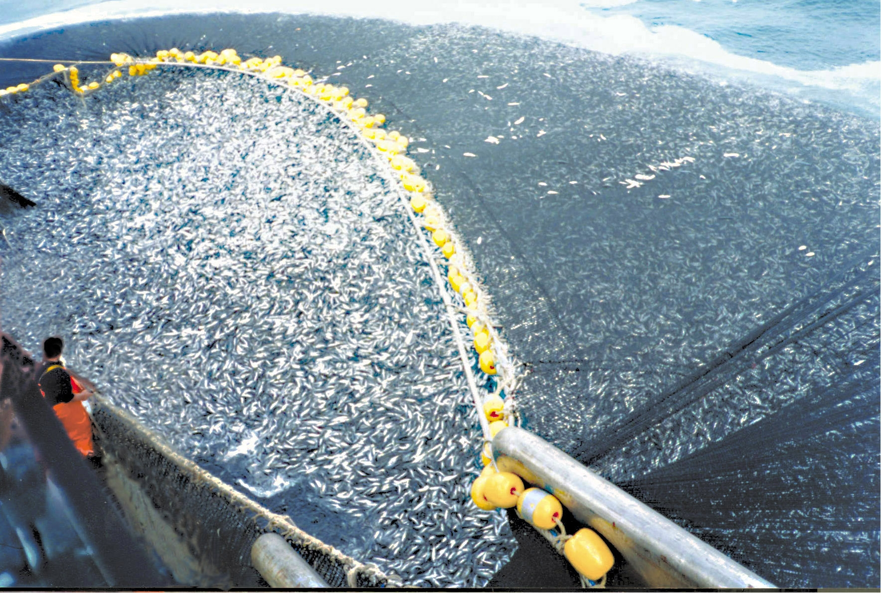
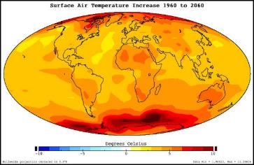
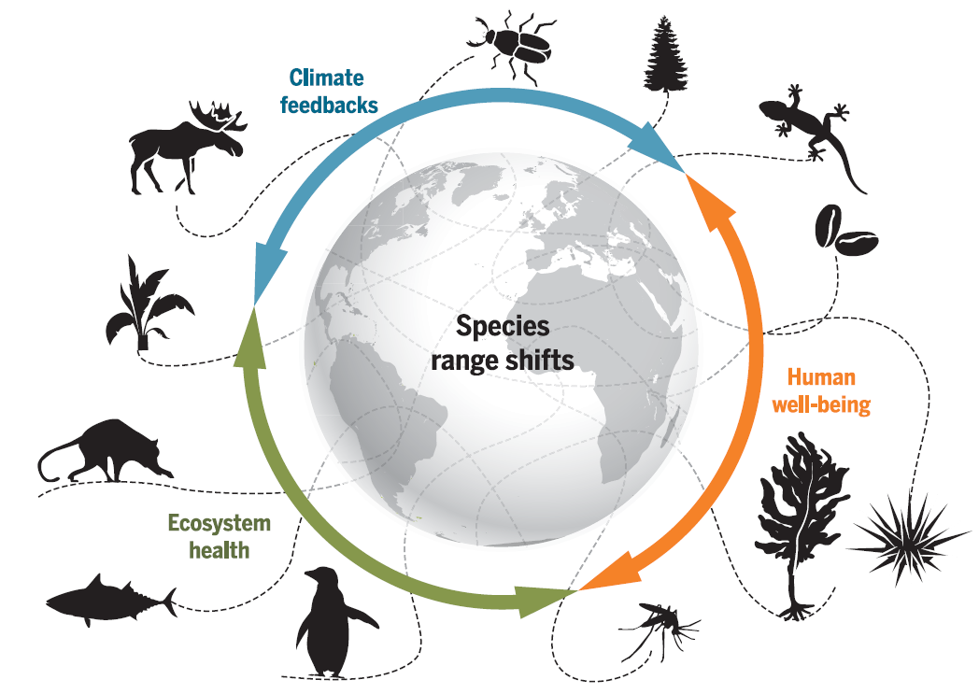


Changes of species distributions
Overexploitation
Climate change
Biological invasion
Habitat loss
Pecl et al. 2017, Science

Slide 37


Global warming and range shifts
35 species of European butterflies
In 63 % range shifted north (35-240 km) during the 20th century, and only 3% shifted south
Twentieth-century changes in the range of Pararge aegeria in Great Britain
1915-1939
1940-1969
1970-1997
Parmesan et al. 1999, Nature
Notes:
A coloured grid cell indicates more than one population in 1915–1939 (black), 1940–1969 (red) or 1970–1997 (blue).

Slide 38


Compare the altitudinal distribution of 171 forest plant species between 1905-1985 and 1986-2005 along the elevations (0 to 2600 m) in west Europe,
A significant upward shift in species optimum elevation averaging 29 meters per decade
Because of climate warming

Slide 39






Range dynamics of
five megafauna species
over the past 2 millennia
Mainly explained by increased agricultural land and agricultural intensification
Time
Teng et al. 2020, PNAS
Notes:
Mainly explained by increased agricultural land and agricultural intensification

Slide 40




Range filling =$\frac{\text{Observed} \text{ranges}}{\text{P}\text{otential} \text{ranges} }$
Human activities reduced ranges of narrow-ranged species but expanded those of widespread species

Slide 41


Spread of alien species
Human-mediated dispersal facilitates global exchange of non-native plants
13,168 plant species have become naturalized somewhere
Flows of naturalized alien plant species among the continents
Spatial pattern of the number of naturalized vascular plant species
van Kleunen et al. 2015, Nature

Slide 42
Some commonly used database of species distributions

Slide 43



GBIF
https://www.gbif.org/
R package: rgbif

Slide 44

OBIS (Ocean Biodiversity Information System)
https://obis.org/

Slide 45


https://bien.nceas.ucsb.edu/bien/
Georeferenced plant occurrences
Plot inventories
Species geographic range maps
Plant traits
Phylogeny
R package: BIEN
Notes:
BIEN is a network of ecologists, botanists, and computer scientists working together to document global patterns of plant diversity, function and distribution.
Here you will find access to:
Georeferenced plant observations from herbarium, plot, and trait records;
Plot inventories and surveys;
Species geographic distribution maps;
Plant traits;
A species-level phylogeny for all plants in the New World;
Cross-continent, continent, and country-level species lists.

Slide 46



IUCN expert range maps
https://www.iucnredlist.org/resources/spatial-data-download
The IUCN Red List of Threatened Species™ contains global assessments for more than 142,500 species. More than 80% of these (>115,000 species) have spatial data.

Slide 47

https://mol.org/

Slide 48


Prof. Mark V. Lomolino

Slide 49
Use range maps in R
Use IUCN and BIEN range maps
Calculate range size
Rasterize range maps
Use GBIF occurrences

